Slide 1
Smyrna
Revelation 2:8-11
Wallace, Steven J. www.revelationandcreation.com

Slide 2
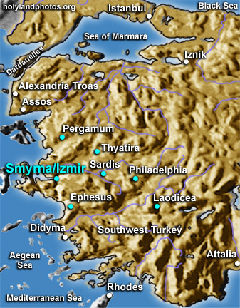
Smyrna
Courtesy of:
www.holylandphotos.org

Slide 3
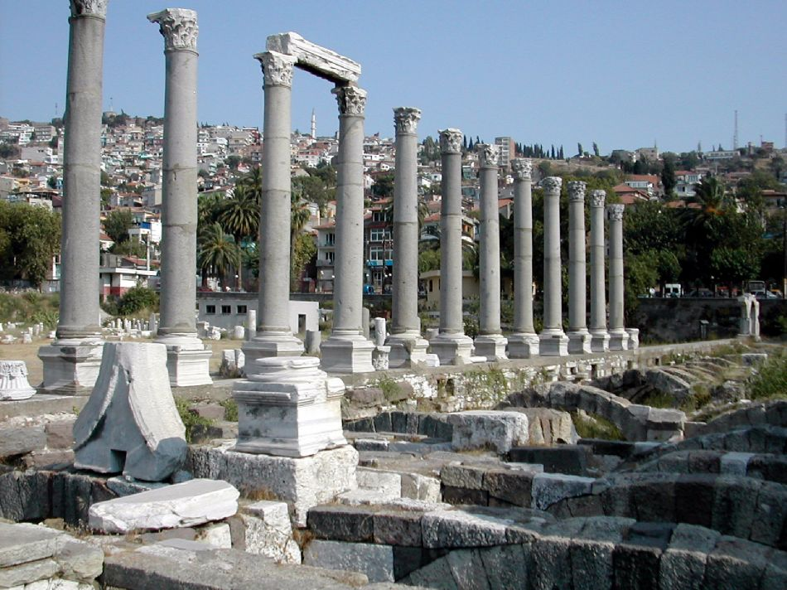
Ancient Ruins of Smyrna Among The Modern City of Izmir
Courtesy of www.holylandphotos.org
40 miles north of Ephesus, “The ornament of Asia”
4th Century B.C. rapidly became the chief city of Asia
Famous for science, medicine, majestic buildings
Polycarp martyred ~A.D. 156
Modern Population: over 4 million (www.allaboutturkey.com/info.htm)

Slide 4
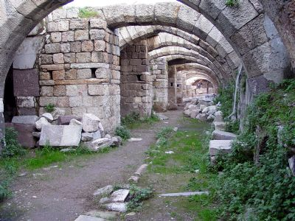
Ancient Ruins of Smyrna Among The Modern City of Izmir
Courtesy of www.holylandphotos.org
Stronghold for emperor worship
Awarded (over 10 other cities) to be the place for a temple dedicated to Tiberius Caesar.
Church existed in a climate of extreme wealth, pride and paganism

Slide 5
Revelation 2:8-11
Salutation (Rev. 2:8)
Divine Praise (Rev. 2:9)
  Jesus knows our works, our situations, and those who are liars. These brethren were poor outwardly, but wealthy in eternity.
Divine Prescription/Promise (Rev. 2:10, 11)
  Do not fear!

Slide 6
Polycarp (69-156 AD)
“Thou threatenest me with fire which burneth for an hour, and after a little is extinguished, but art ignorant of the fire of the coming judgment and of eternal punishment, reserved for the ungodly. But why tarriest thou? Bring forth what thou wilt.”
The Martyrdom of Polycarp, chap. 11

Slide 7
Polycarp (69-156 AD)
“His blood will God require of those who do not believe in Him. But He who raised Him up from the dead will raise up us also, if we do His will, and walk in His commandments, and love what He loved, keeping ourselves from all unrighteousness, covetousness, love of money, evil speaking, false witness.”
Epistle to the Philippians, chap. 2

